Slide 1

Effects of Bass Guitar Pickups on Pitch Detection and Shifting
By Saketh Aripirala

Slide 2
Goals
Understand the DSP implementations of pitch detection and shifting algorithms.
Identify the role of pickups in DSP applications of pitch detection and shifting
Detecting and flagging errors appropriately
Evaluate and analyze the harmonic contents of certain pickup types to evaluate the potential causes for errors.
Note: The DSP applications are specialized by Darkglass Electronics’ own implementations. Therefore, the results may not necessarily imply that a pickup’s nature is outright unusable for these applications.

Slide 3
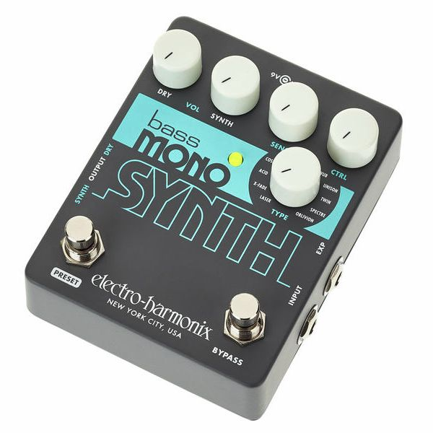
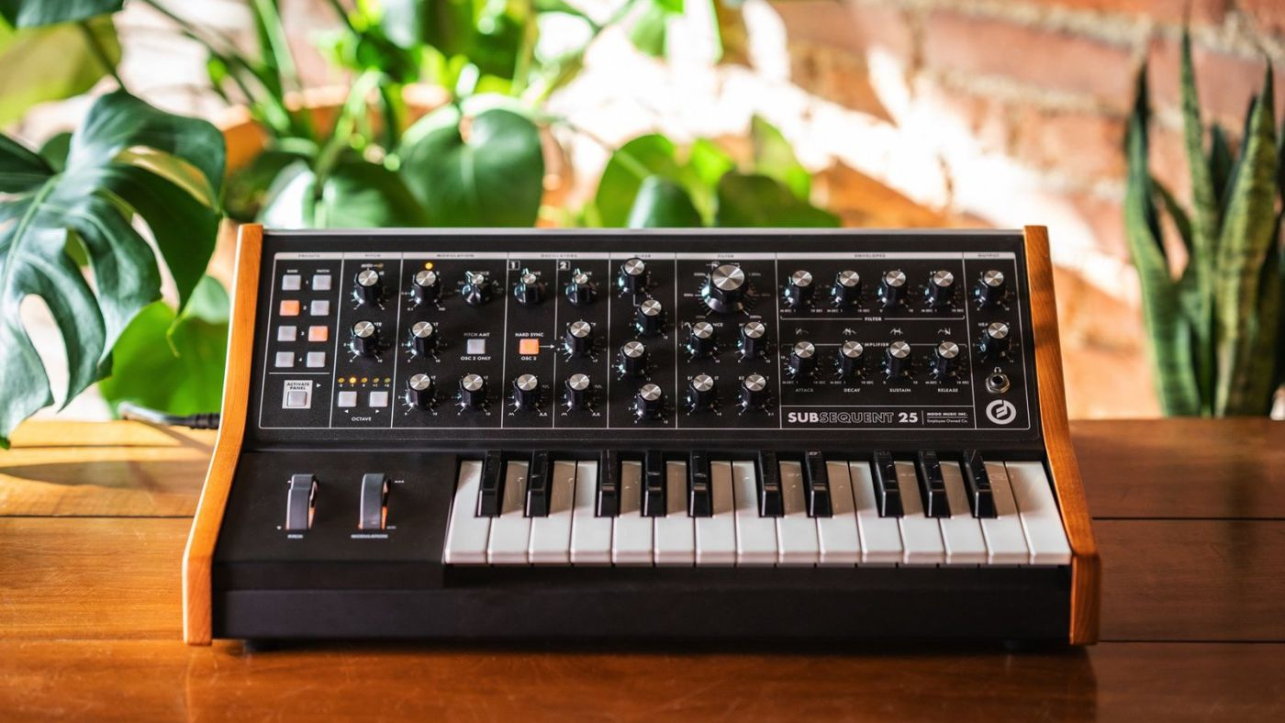
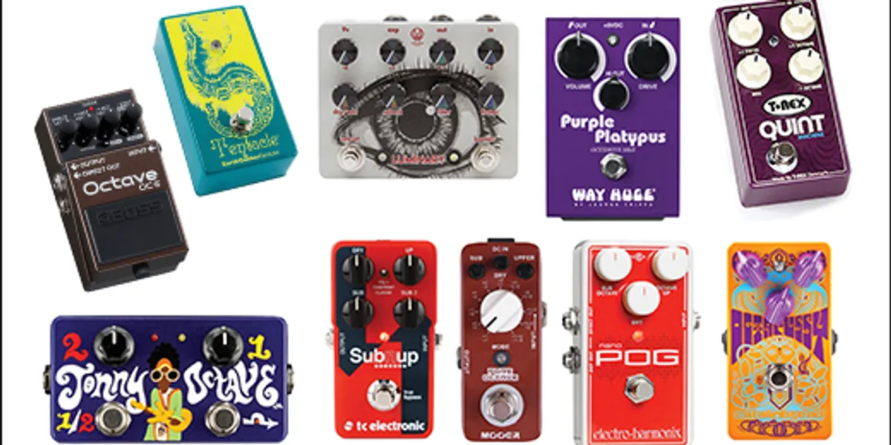
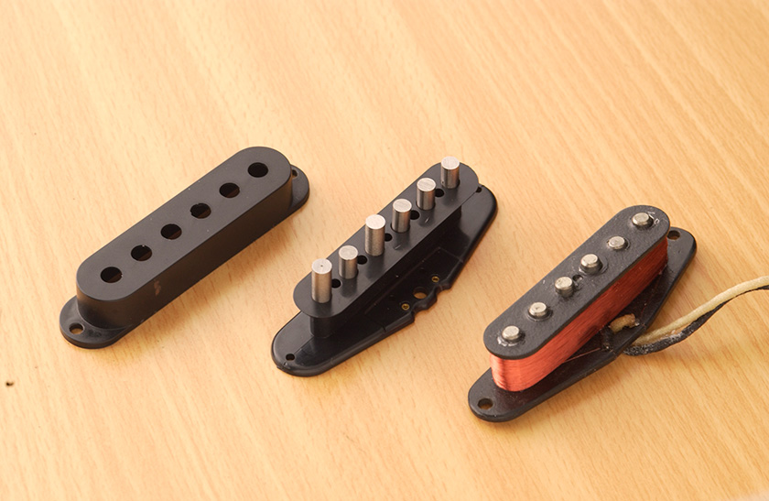
Prerequisites
Synthesizer
The YIN Algorithm
Octaver Model
Pickup Fundamentals
Piezo & Humbuckers

Slide 4
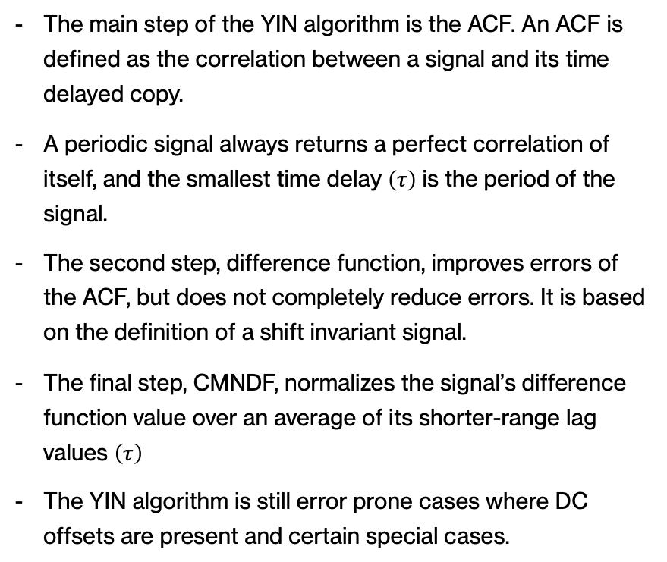
The YIN Algorithm and Errors.
The YIN algorithm by Hideki Kawahara and Alain de Cheveigné is an algorithm used for pitch detection, also known as F0 estimation.
In music, the pitch is commonly referred to as the fundamental frequency (F0), as subsequent harmonics do not massively affect the perception of the pitch.
The YIN algorithm mainly performs three operation to estimate the F0 of a signal, namely:
Auto Correlation Function (ACF)
Difference Function
Cumulative Mean Normalized Difference Function (CMNDF)
The main step of the YIN algorithm is the ACF. An ACF is defined as the correlation between a signal and its time delayed copy.
A periodic signal always returns a perfect correlation of itself, and the smallest time delay $\left(τ\right)$ is the period of the signal.
The second step, difference function, improves errors of the ACF, but does not completely reduce errors. It is based on the definition of a shift invariant signal.
The final step, CMNDF, normalizes the signal’s difference function value over an average of its shorter-range lag values $\left(τ\right)$
The YIN algorithm is still error prone cases where DC offsets are present and certain special cases.

Slide 5
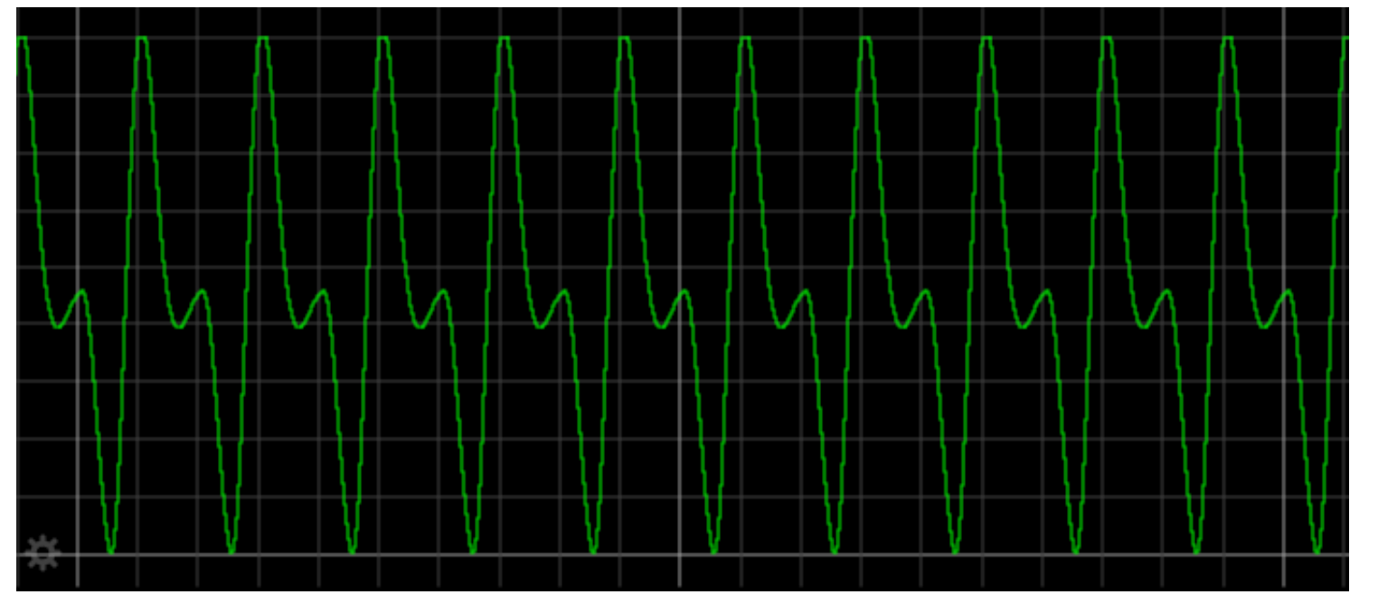
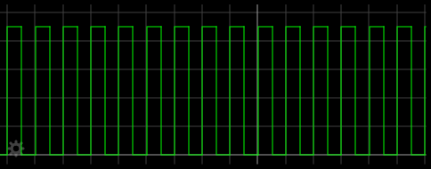
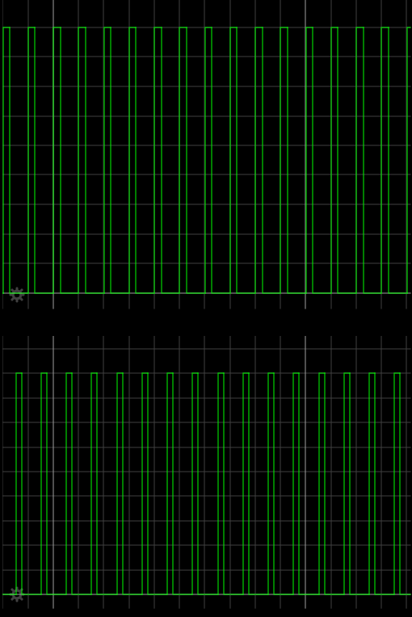
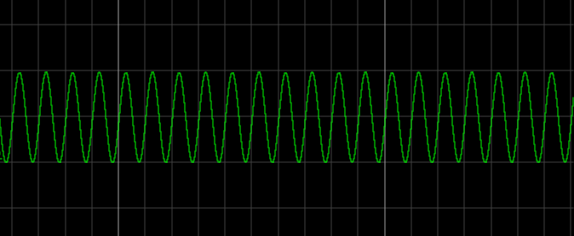
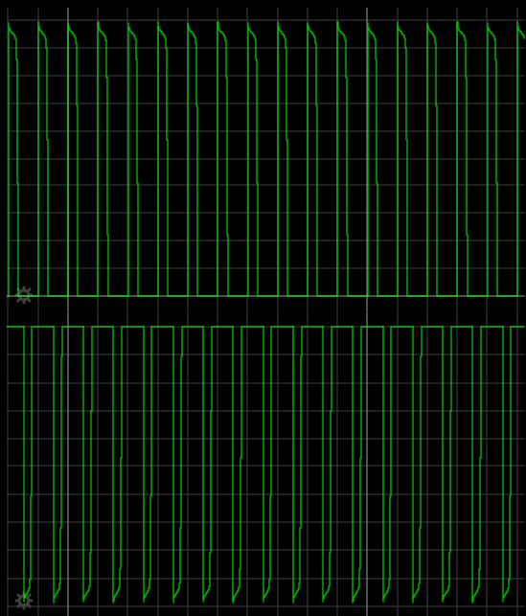
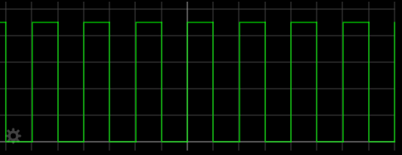
Analog Octaver
An octaver is a device that shifts the signal down a musical interval of an octave, thus halving the frequency.
Analog Octavers typically achieve this by generating a control signal that manipulates the incoming signal.
In this specific instance, the main type of analog octavers used were the mute style.
The mute style generates square waves at double the period of an input signal and uses JFET circuits to mute the incoming signal.
An octaver can be modelled by applying the logic of analog components.
Positive Peak Detector
New Peak Comparators
Positive and Negative Peak Set-Reset Cycle
Signal Input
Flip-Flop #1
Negative Peak Detector
Octave Divider
Signal Output
Filtering
JFET Muting
Flip-Flop #2
Top Peaks
Top Peaks
Bottom Peaks
Bottom Peaks
Flip Flop #1: Set-Reset Cycle Generator
Flip Flop #2: Period Doubler

Slide 6
Octaver Errors
Typically, two errors are common for an octaver:
Octave Error: Signal shifts UP an octave.
Phase Error: Muting signal is out of phase.
An octave error is the most audible error. The signal clearly sounds different from the note played. Sometimes the signal may shift slightly above or below the note, thus causing a deviation.
A phase error is is less obvious when perceived, but in some extreme cases the signal clearly produces a change.
Phase errors also make the mixing of signals harder due to destructive interference.

Slide 7
Pickups
Pickups are transducers that capture the sound of a string.
Traditionally, there are two types of pickups:
Magnetic Pickups
Piezo Pickups
The definition of sonic qualities of a stringed instrument is largely dependent on the pickup.

Slide 8
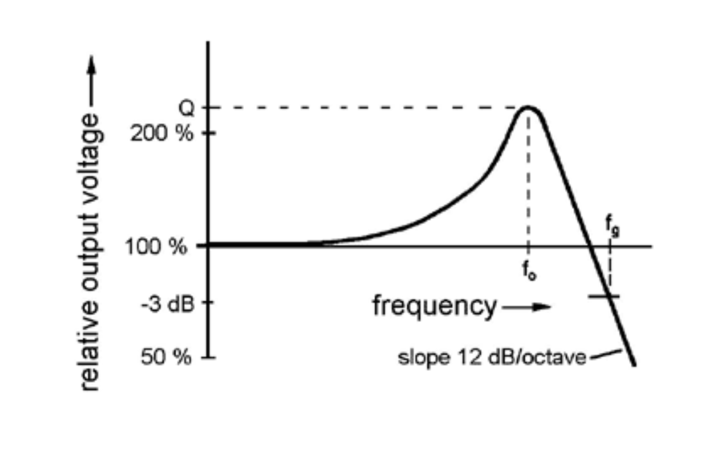
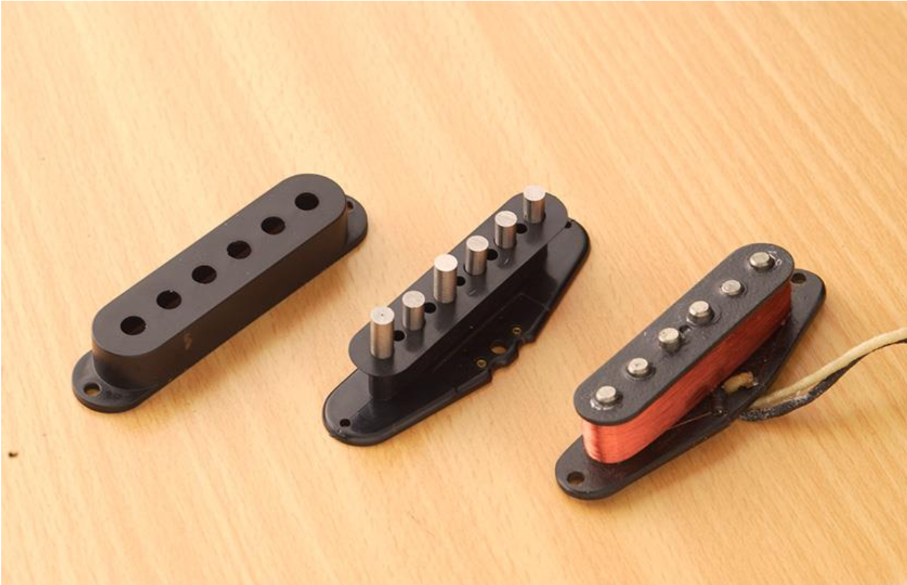
Magnetic Pickups
Magnetic pickups are based on Farday’s Law of Induction, which states that a change in the magnetic field induces current into a coil.
Magnetic pickups are constructed by winding a wire around a permanent magnet (pole piece).
A magnetic pickup can be simplified to an LCR circuit with the pickup treated as an AC voltage source. The frequency response characteristics are shown below:
There are two types of magnetic pickups:
Single Coil: A single set of magnetic pole piece is used.
Humbucker: Two sets of magnetic pole pieces with opposite phase relationship is used.
Single coils are susceptible to noise and RFs. Humbuckers overcome this due to their construction.
Humbuckers can be connected in two configuration:
Split-Coil: One of the coils is grounded. More HF but removes the “humbucking” effect.
Series-Parallel: Connects the coils in series or parallel. More HF and preserves the ”humbucking” effect.

Slide 9
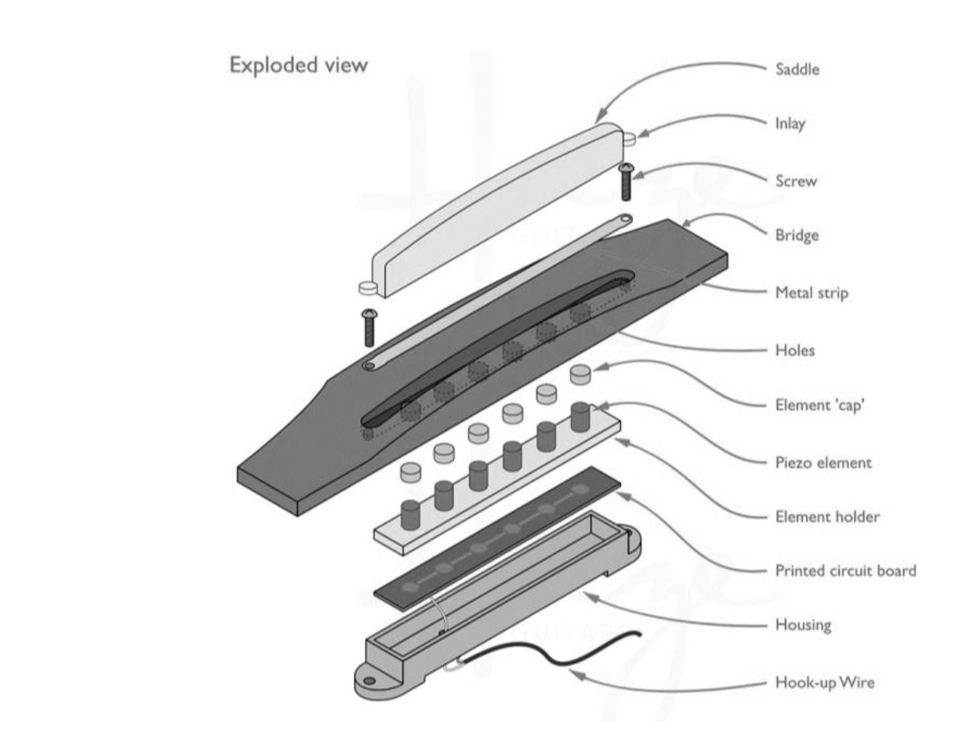
Piezo Pickups
Piezo pickups operate on the principle of piezo-electricity.
Crystals are utilized in piezo pickups and they naturally produce voltage across them when subjected to stress.
The signal output of piezo pickups is non-linear in nature and typically requires a pre-amplifier since the signal is weak.
Compression is an effect used to establish more control on the non-linear output.

Slide 10
Testing Methods
A bass guitar was modified to contain a humbucker and piezo pickup to record signals simulatneously.
To provide debugging outputs and establish modularity, a debugging pre-amplifier was designed for the bass guitar.
Power supply filtering and protection, RF shielding, and methods to reduce THD+N were implemented for optimal signal to noise performance.
Signals are then subjected with the algorithms under test and the signal is correlated to an ideal application. A python script was developed to perform the correlation & analysis.
A spectral analysis of the signal was performed using Sonic Visualizer to reveal the fundamental differences and find causes for errors.
4 Test signals were utilized for the synthesizer and octaver algorithms.

Slide 11
Testing Data Flow and Areas of Interest
Bass Guitar
Algorithm Under Test
Octaver & Synth DSP
Areas of Interest:
Tracking Stability
Pitch Deviations
Setting Times
Error Conditions
Spectral Data
Humbucker
Piezo
Algorithm Under Test
Spectral Analysis (Sonic Visualizer)
Algorithm Under Test
Python & Sonic Visualizer Data Flow
Pitch (F0) Estimation – PYSPTK
Pitch Difference Calculations – Flagging Mechanism
Plotting Correlation Data

Slide 12
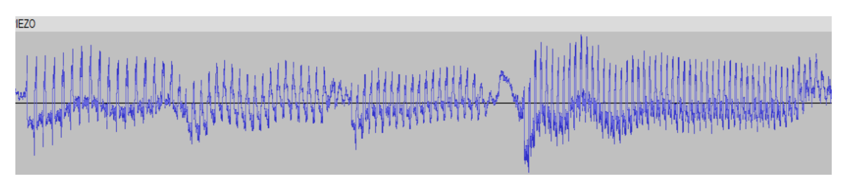
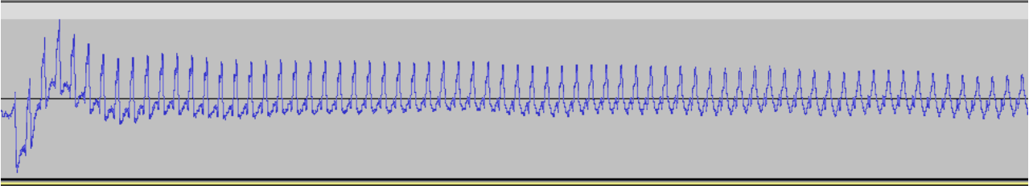
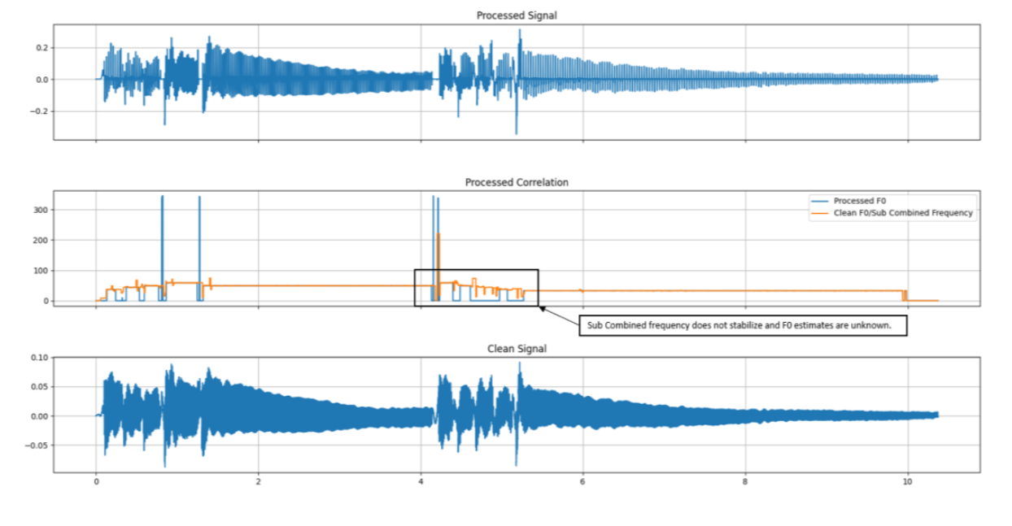
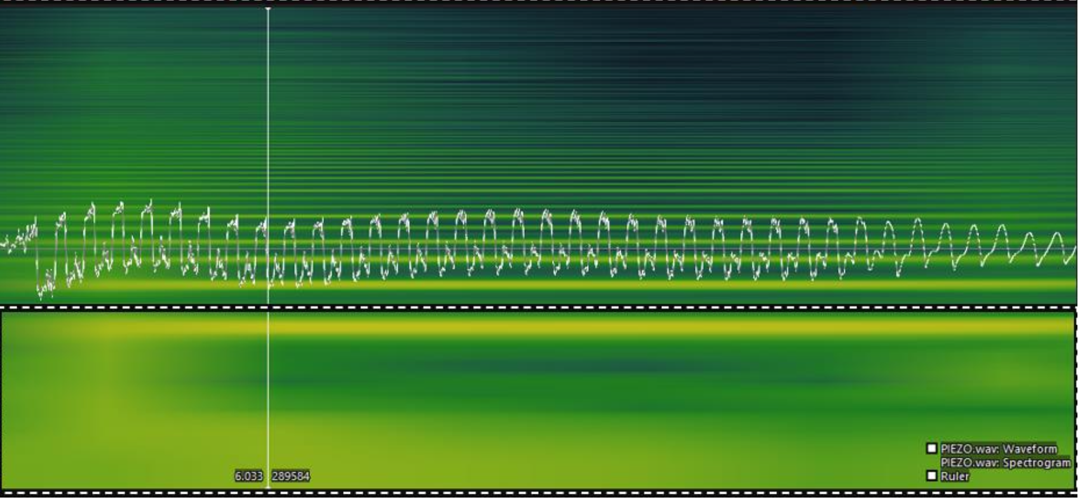
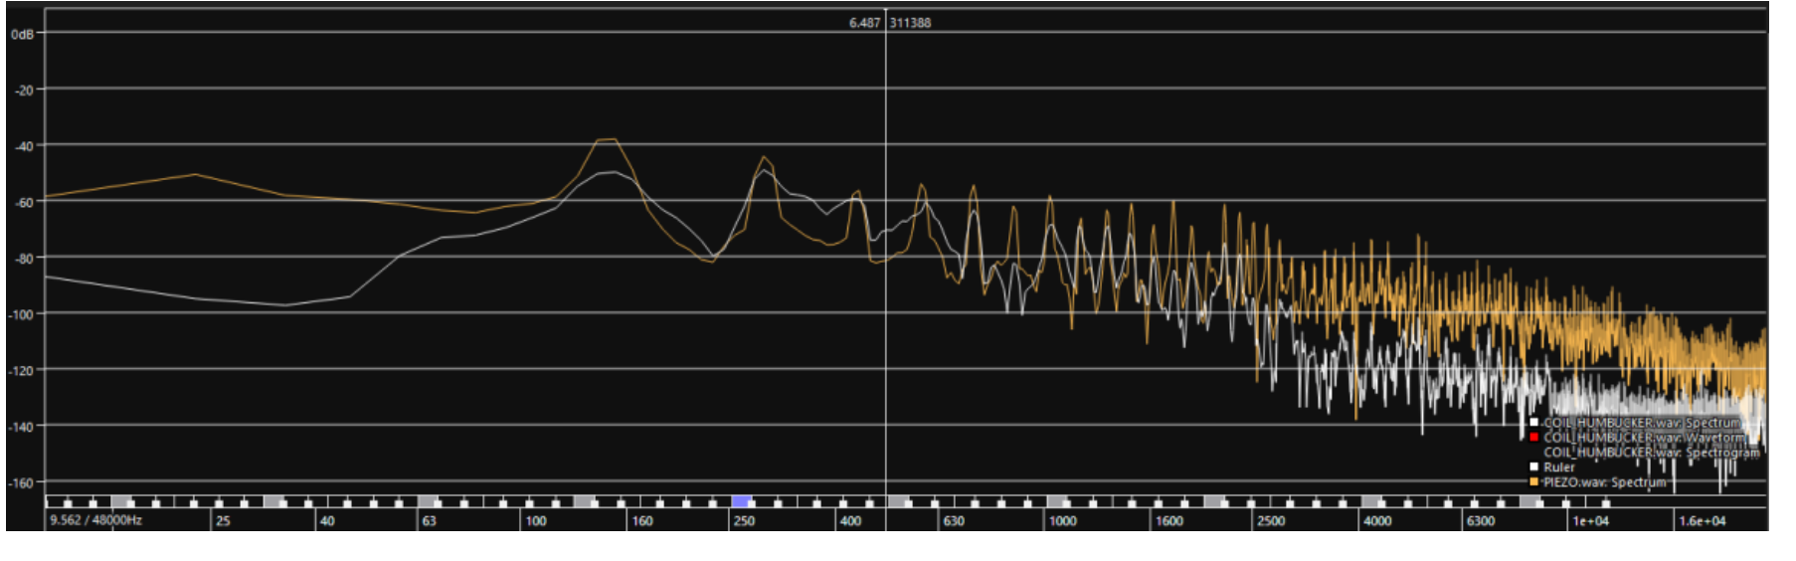
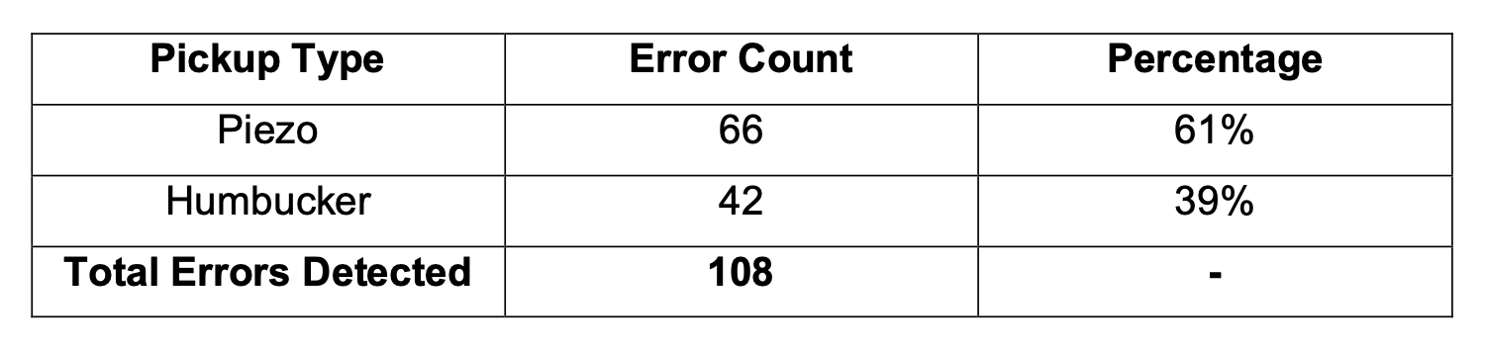
Results
The results showed that the piezo was more prone errors with the Darkglass DSP implementations of pitch detection and shifting.
Errors were also mostly octave/deviation errors with one case of a phase error.
Main causes of errors were due to significant DC shifts with a low frequency oscillation.
The piezo pickup contained weak negative peak amplitude which bore effects when the signal was offset.
In certain cases, the piezo pickup did not recover for the entire duration of the audio.
Final Error Percentages are presented below:
Spectral analysis revealed that the piezo contained HF contents and infra-audio contents (sub 20Hz).
The humbucker contained a dominant presence of the second harmonic over the fundamental.

Slide 13
Main Takeaways
Although the piezo produced the more errors, applications where the piezo is much more favorable than the humbucker were discovered.
The errors produced by the piezo can be reduced by only tracking the positive peak.
Hexaphonic pickups can also be utilized for implementing the synthesizer since they are much more common in MIDI guitar synthesizers.

